Slide 1
Domain Bucket : Software - Mobile App Development Problem Statement Number : NM-381
Category : Software Organization : Indian Space Research Organization(ISRO)
Team Name :
College Code : U-0923
PROBLEM STATEMENT TITLE
App for Identification of Sky regions in a photo
TECHNOLOGY STACK:
SOFTWARE: Android based Application
HARDWARE:
LANGUAGES USED: Python

Slide 2
PROBLEM DESCRIPTION:
Generating local sky horizon has important applications for analysis of solar energy potential in an urban setting. Develop a mobile application for automatically detecting sky pixels in a photograph. The application should generate a mask image consisting of sky pixels marked in white colour in the image and other pixels marked in black colour. Further, using information about camera optics, the application should give angle of elevation of the lowest sky pixel for all pixel columns in the mask image.

Slide 3
Team Member Details
Reg.No | Name | Year/ Semester | School/ Department | Male/ Female | Mail Id | Phone . No
18BCE10196 | Prayag Bhatnagar | II/4th | SCSCE | Male | prayag.bhatnagar2018@vitbhopal.ac.in | 7683052126
18BCE10254 | Shreeyash Jejurkar | II/4th | SCSE | Male | shreeyash.jejurkar2018@vitbhopal.ac.in | 9130876690
18BCE10015 | Aditya Yadav | II/4th | SCSE | Male | aditya.yadav2018@vitbhopal.ac.in | 8005027264
18BCE10145 | Kritika Shah | II/4th | SCSE | Female | kritika.shah2018@vitbhopal.ac.in | 8602028557
18BCG10048 | Hritvik Semwal | II/4th | SCSE | Male | hritvik.semwal2018@vitbhopal.ac.in | 9879782612
18BCY10054 | Mihir Semwal | II/4th | SCSE | Male | mihir.semwal2018@vitbhopal.ac.in | 9354012483

Slide 4
Mentor Detail
Staff Id | Name | School/ Department | Mail Id | Phone . No
100135 | Dr. Ajit Kumar | SCSE | ajit.kumar@vitbhopal.ac.in | 8903144954
Note: Mentor Needs to be at least 4+ year industry/Academia experience.

Slide 5
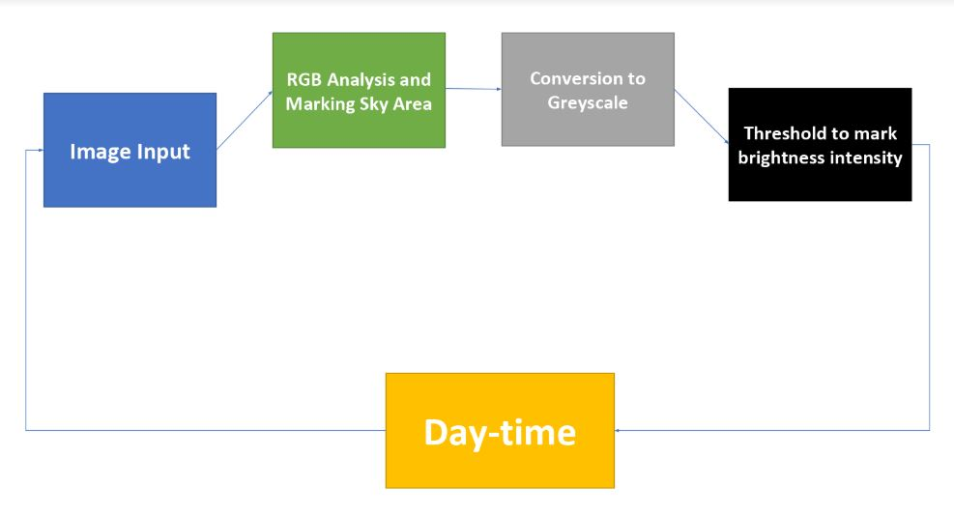
Proposed Solution Architecture /Use Case Diagram

Slide 6
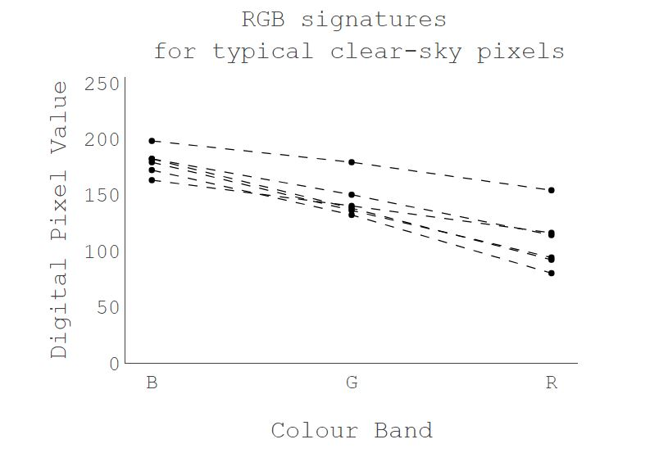
Proposed Solution
Image analysis of the sky from different angles and during different durations during daytime :
1. Find the total sky area.
RGB analysis of the image to mark the sky area. Typically, the RGB values of sky pixels have following signatures

Slide 7
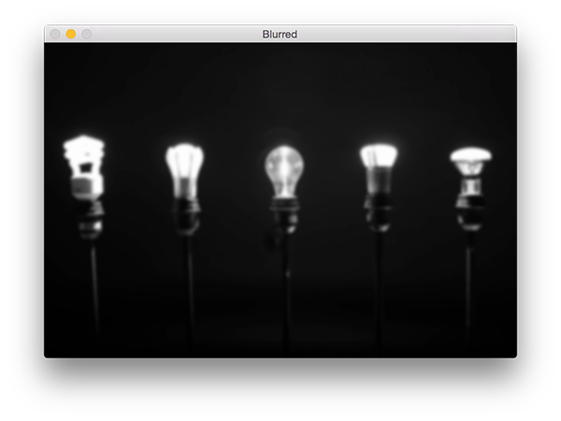
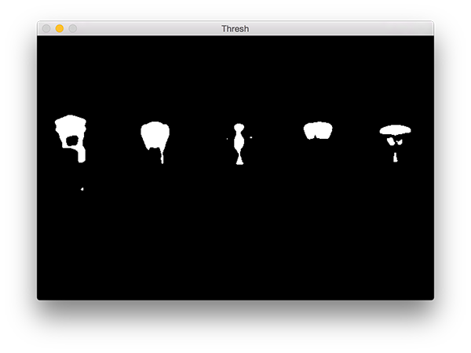
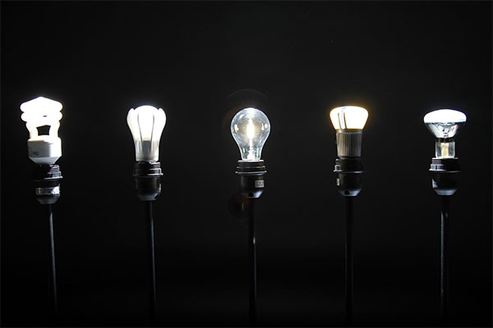
Proposed Solution - Cont.
2. If the sky area is more than 50%, find out the “bright spots”, i.e the areas of the image receiving ample sunlight
1. Grayscale conversion of the Image and blurring to smoothen high frequency noise i.e trees, buildings.
2.Thresholding of the Image to find out the bright spots.
Thresholding involves calculating area where pixel value > 200, and set it to 255 i.e white and rest of the area to 0 i.e black.
3. Continue this operation for entire duration of daytime to calculate sunlight exposure at various times of the day and total sunlight exposure during the entire daytime.

